Slide 1
Techniques of Compiler （编译技术） Lecture 1 Introduction
Ying Weiqin (应伟勤)
yingweiqin@scut.edu.cn

Slide 2
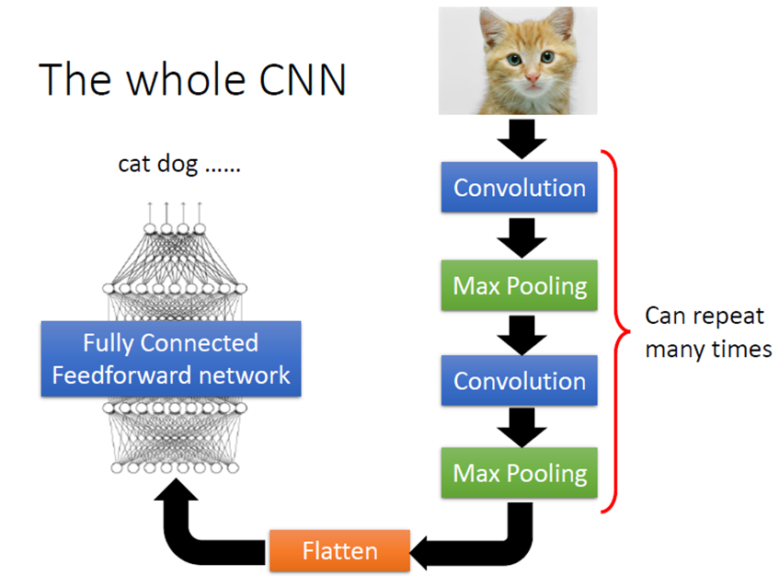
深度神经网络的根本优势-自动化特征工程

Slide 3
多目标异构深度神经架构搜索NAS（Neural Architecture Search）-神经架构设计自动化

Slide 4
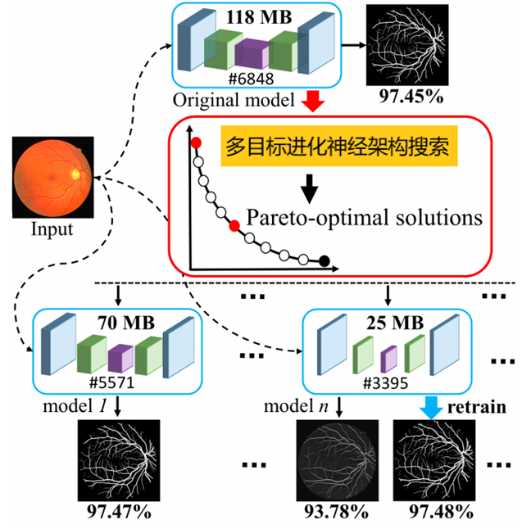
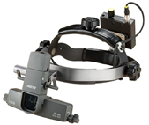



多目标异构深度神经架构搜索NAS（Neural Architecture Search） -神经架构设计自动化
多目标异构深度神经架构搜索可一次生成不同大小的优质异构网络架构，适配具不同计算能力的部署场景

Slide 5
Outline
1 Course Information
2 The History of Programming Languages and Compilers
3 The Structure of a Compiler
4 Language Process
5
Notes:
5

Slide 6
1-1 Course Information
Section 1 Introduction
Ying Weiqin
School of Software Engineering

Slide 7
Course Schedule
Starting on Mar-10th -2025, 3 sections every week on Monday afternoon, from the 3rd week to the 14th week, and 2 sections every week on Monday afternoon from the 15th week to the 16th week.
We will have 4 times of laboratory course, 4 sections a time.
Teacher: yingweiqin@scut.edu.cn

Slide 8
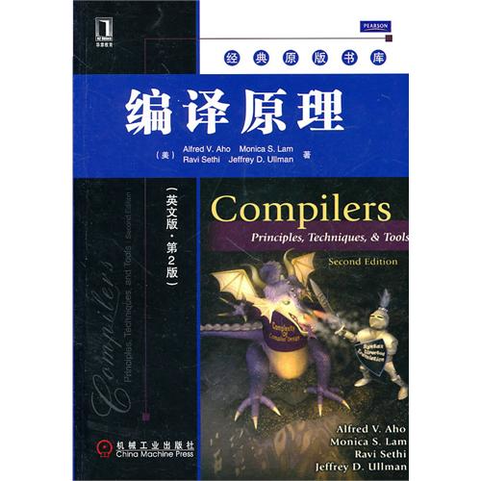
Textbook
Compilers: Principles, Techniques, and Tools
by Aho, Lam, Sethi, and Ullman—also known as "The Purple Dragon Book"
CS164 in Berkeley and CS143 in Stanford

Slide 9
Cover Topic
9
“Techniques of Compiler” introduces the students to the principles and technologies of programming language implementation.
We cover lexical analysis, parsing theory (syntax analysis), semantic analysis, and code generation (intermediate code generation).

Slide 10
Grading
The coursework will consist of assignments, attendance, coding experiments, and a final exam.
assignments and attendance: 10%
Coding experiments: 20%
Final exam: 70%

Slide 11
Why Compiler
The development of programming language
Machine language (C7 06 0000 0002)
Assembly language (MOV x,2)
High-level language (x=2)
Computer can only execute the machine instructions
High-level programs need to be translated to machine code

Slide 12
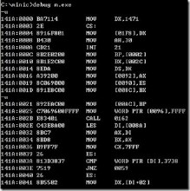
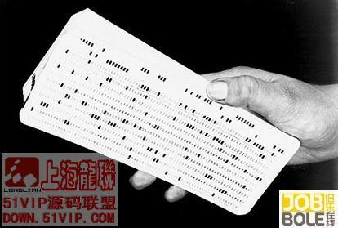
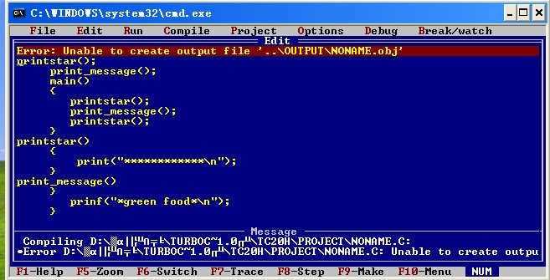
Why Compiler

Slide 13
What is Compiler
Compilers are computer programs that translate programs from one language to another
Source Program
Compiler
Target Program
input: usually written in high-level language (such as C,C++)
output: usually object code for the target machine (such as machine language, assembly language)
Target program
input
output

